Slide 1
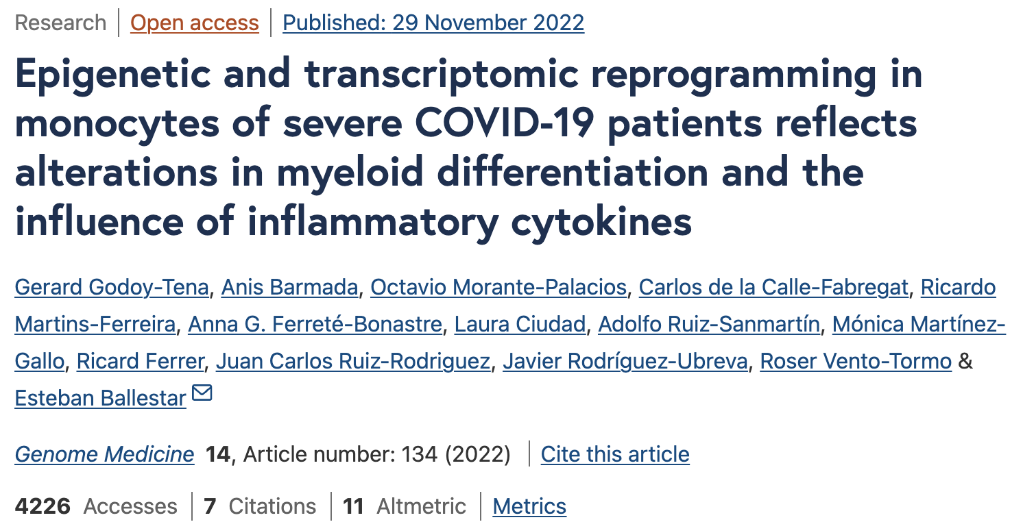
Team #1

Slide 2
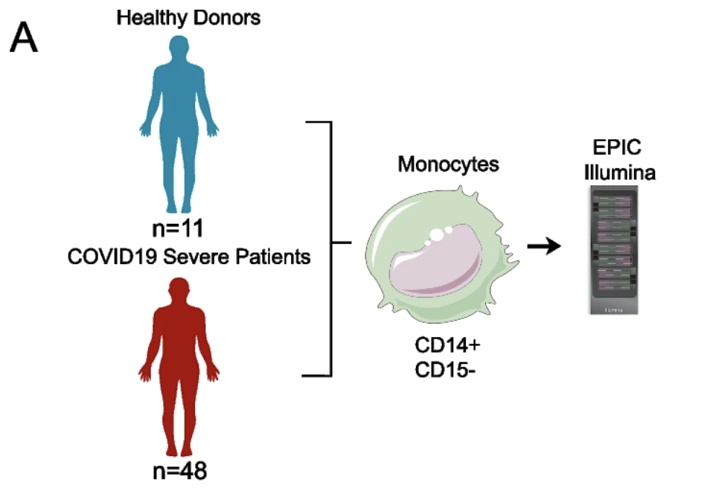
Samples and main question
Total 59 blood samples
48 severe COVID-19 patientes
11 healthy donors (HDs)
What are the epigenetic alterations that occur monocytes during hyperinflammatory responses in severe COVID-19 patients?

Slide 3
Pipeline
ShinyÉPICo
Success of array
Success of disulphite assay
Exclude regions not of interest (chr X and Y)
SNP removal (Noob)
Filtering by FDR and delta b
iEVORA - equality of variance by Barlett’s test (FDR < 0.001)
Motif enrichment (HOMER)
GREAT for GO
Chromatin functional state enrichment with ChromHMM
Association analysis
DMPs
DEG analysis
Quality Control
DVPs
Genomic regions characterization
limma
Batch correction (technical variation vs biological variation), followed by PCA
Quantile normalization (minfi)
differentially methylated CpG sites by using t-tests
Include relevant covariates in the analysis
Hypermethylation correlation (Spearman) with SOFA categories
Used limma for DEG
DoRothEA for TF analysis
Notes:
You can predict gender from methylome, then corroborate with metadata.

Slide 4
EPIC arrays
QC and analysis of EPIC with ShinyÉPICo
uses minfi for normalization
The red/green ratio for each control position was calculated for each sample
conversion rate was above the quality threshold of 2 established by Illumina
chromosomes X and Y were also excluded
Uses limma for analyzing differentially methylated positions
batch effect correction
Sex and age of the donors were included as covariates
Trend and Robust options were implemented in the eBayes moderated t-test analysis
identified differentially methylated CpG sites by using t-tests and a method with defined empirical array weights, included in the limma package (FDR of < 0.05 and a Δβ of > 0.15)
identify differentially variable positions (DVPs) used iEVORA
SOFA association to changes in CpG methylation calculated with spearman correlation (rho > 0.4 and p < 0.01.)
GREAT for GO
motif enrichment done with findMotifsGenome.pt tool from the motif discovery HOMER software
Generate chromatin functional state enrichment with ChromHMM
DGEA done with limma
transcription factor (TF) involvement in transcriptomic changes, we used DoRothEA
Overlap between DVPs and Ensembl Regulatory Build (from GSE87197) using GenomicRanges
Compare and check overlap between GSE138074 (DMP from sepsis) and their data under assumption: severe COVID-19 can be considered a form of sepsis using OddsRatio.

Slide 5
EPIC arrays
Single cell analysis
Cell ranger
Souporcell - demultiplexing
Scrublet - duplets removal
single-cell variational inference (scVI) performed by merging other datasets of of HDs

